Slide 1
STARBUCKS WEB APPLICATION
The Ninjas: Junteng Tan, Jia Ma, Ying Liu

Slide 2
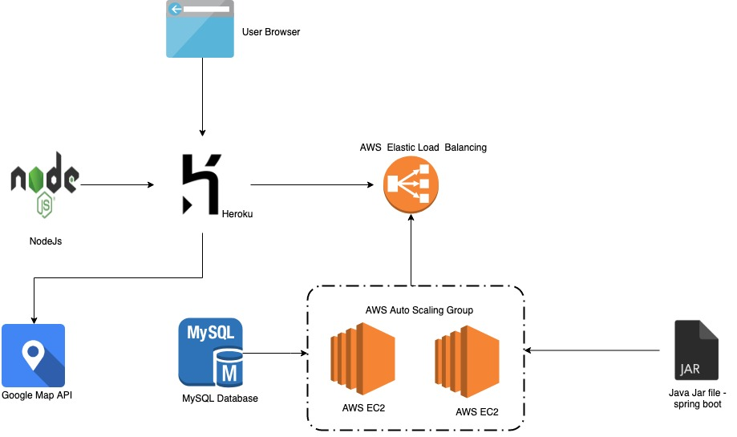
Deployment Diagram

Slide 3
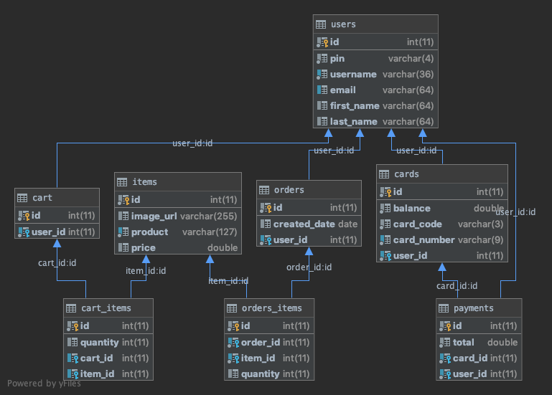
Database Design

Slide 4
Team Members Contributions
Add Cards API (Jia Ma)
Managed Order API (JunTeng Tan)
Payment API (JunTeng Tan)
User API (Ying Liu)
Map API (Jia Ma)
Extra: Deploy API to AWS in an Auto Scaled EC2 Cluster with Load Balancer (JunTeng Tan)
Extra: Web "Front-End" Deployed to Heroku for Starbucks Payment Card management:
https://starbucks-web-map.herokuapp.com/#/products (Jia Ma)
Agile project management and documentation: Ying Liu

Slide 5
AGILE & SCRUM
Ying Liu

Slide 6
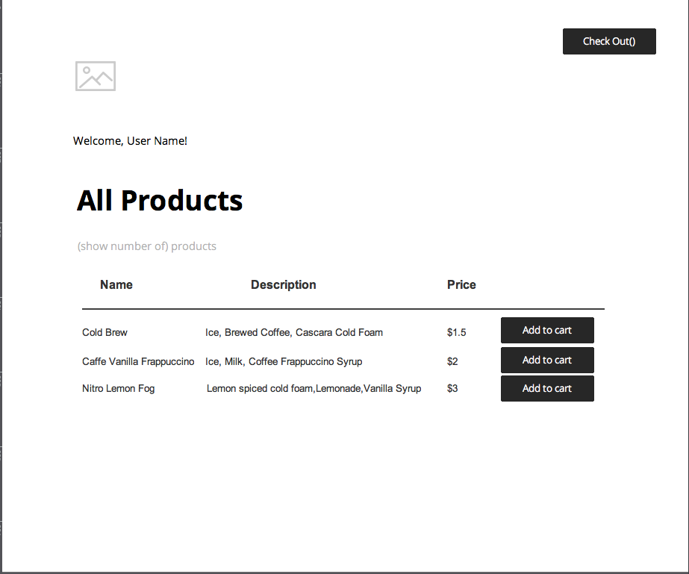
UI Wireframe (Used a drawing tool: JustinMind)

Slide 7
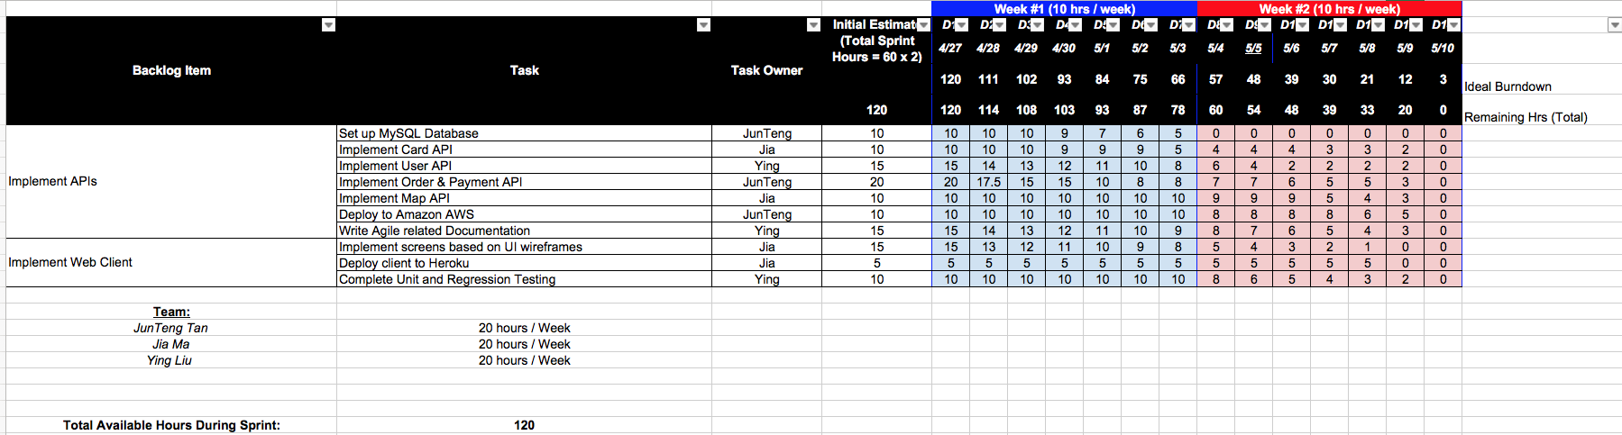
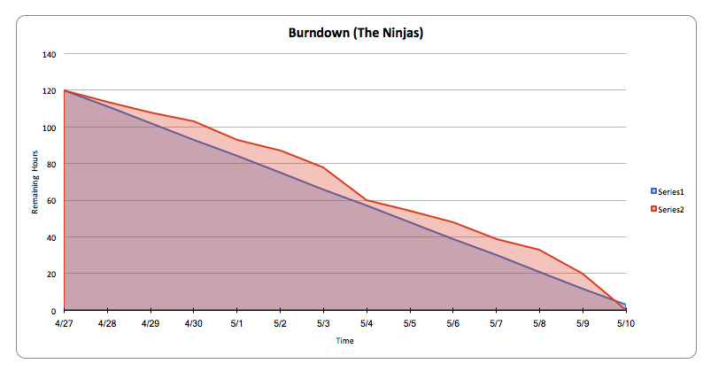
Burndown Chart

Slide 8
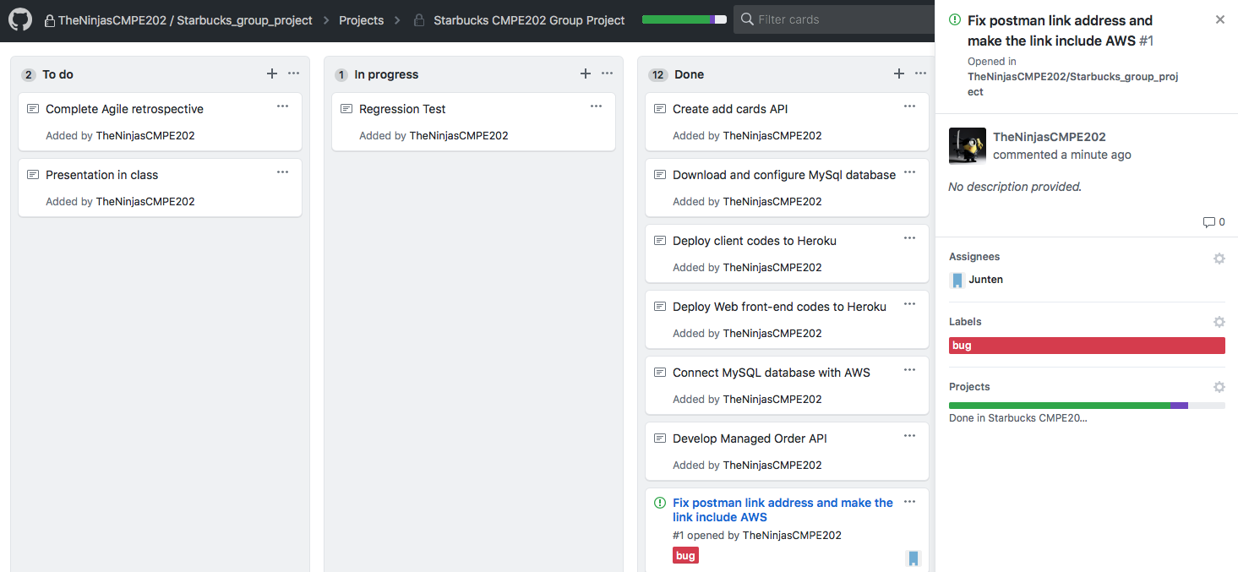
Agile Board

Slide 9
API DEMO
Junteng Tan

Slide 10
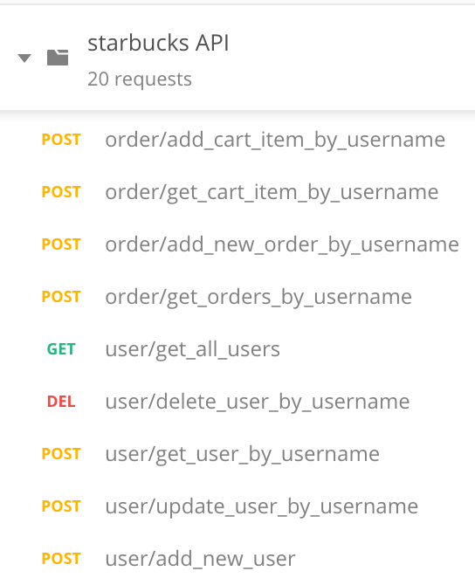
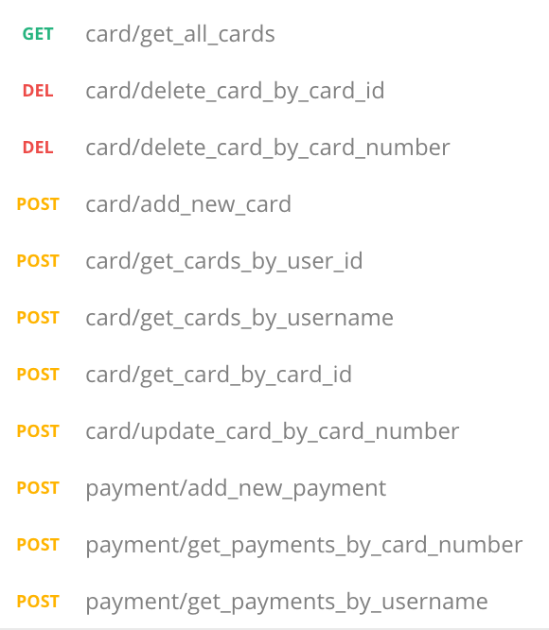

Slide 11
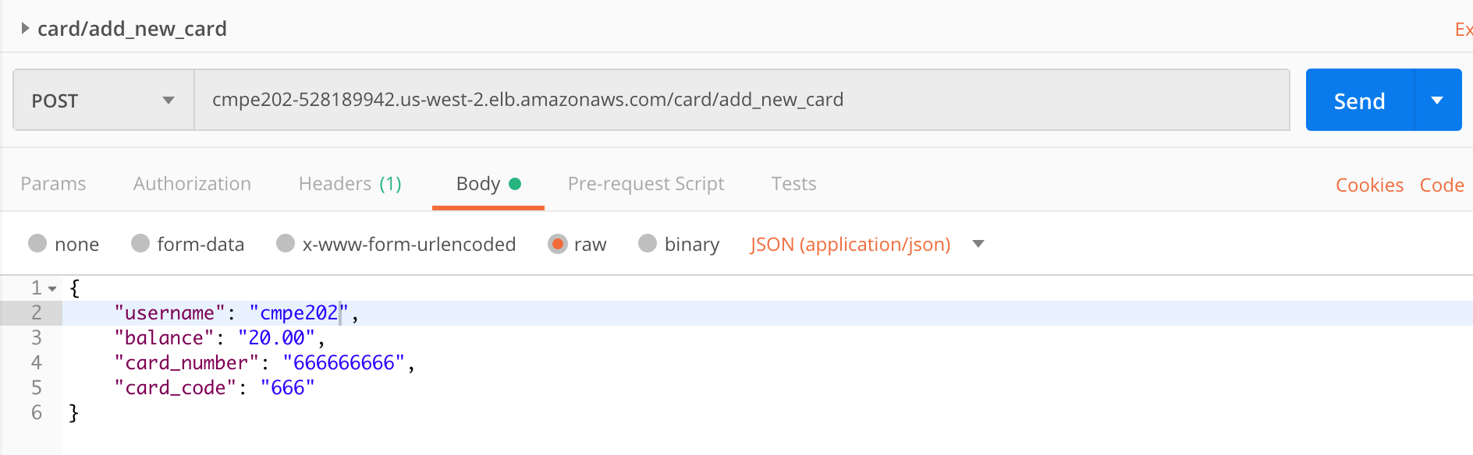
Add New Card

Slide 12
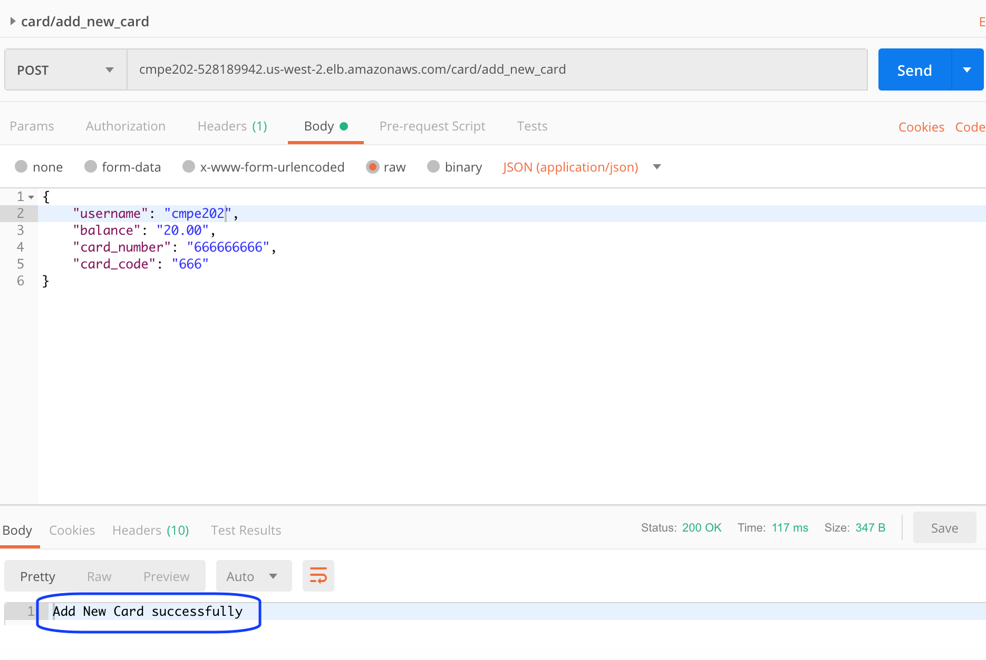

Slide 13
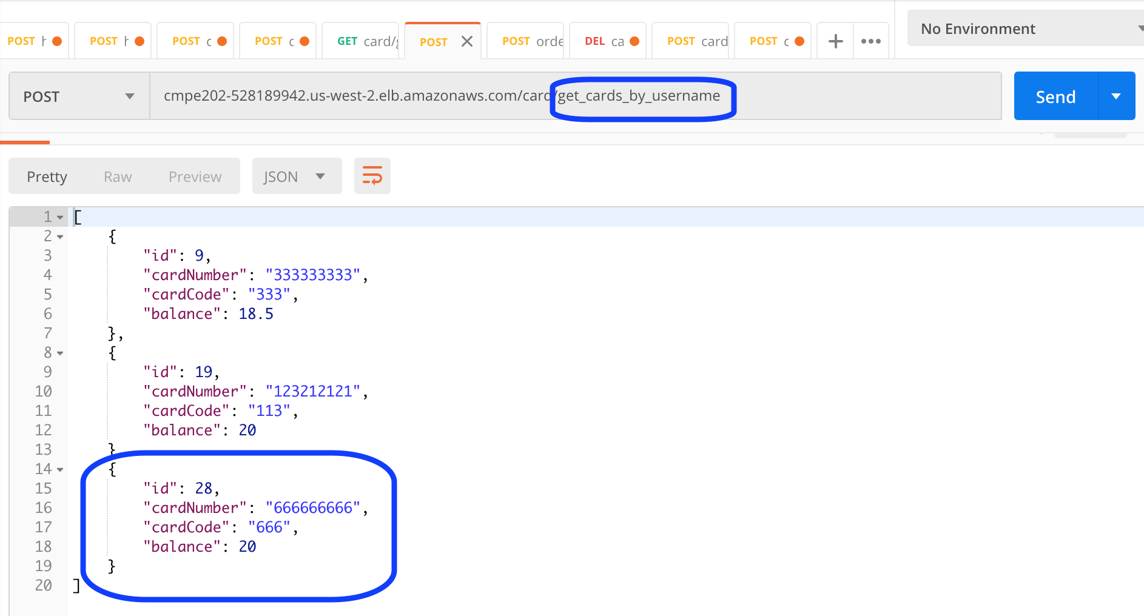

Slide 14
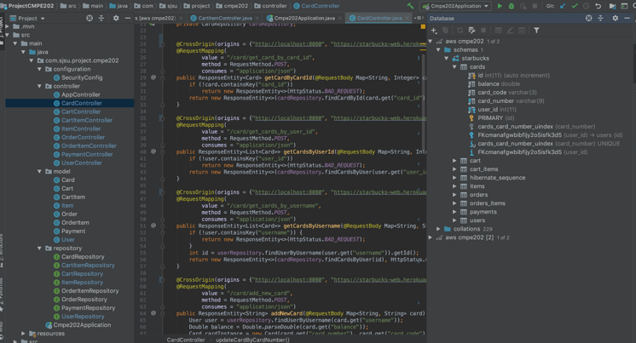

Slide 15
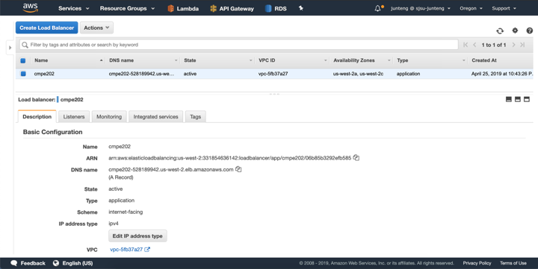

Slide 16
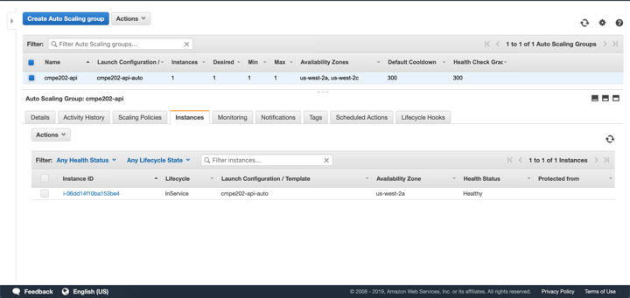

Slide 17
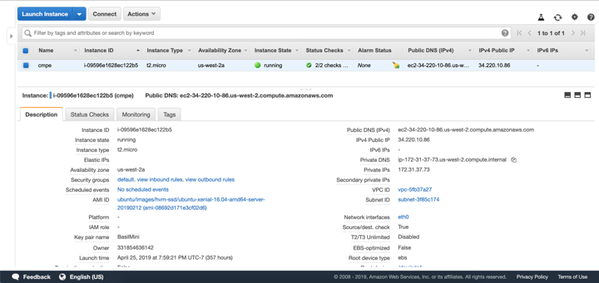

Slide 18
WEB DEMO
Jia Ma

Slide 19
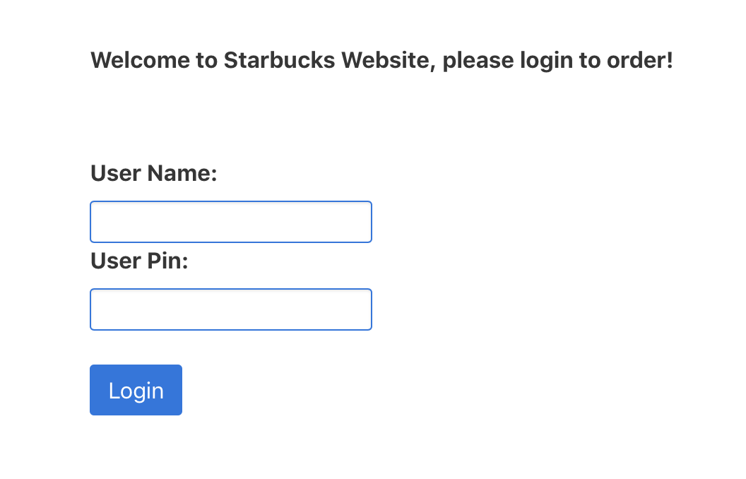
Log in: https://starbucks-web-map.herokuapp.com/ User: Jenny Password: 1234

Slide 20
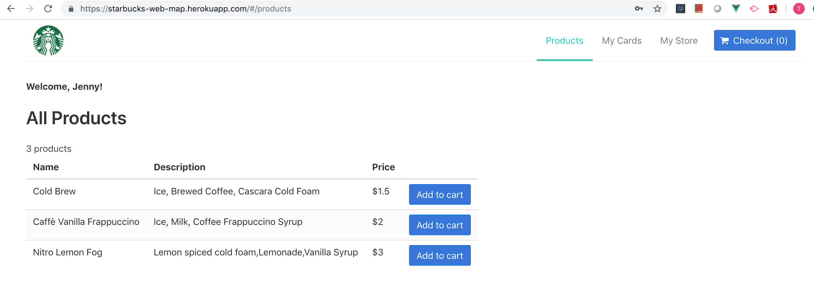
Products List

Slide 21
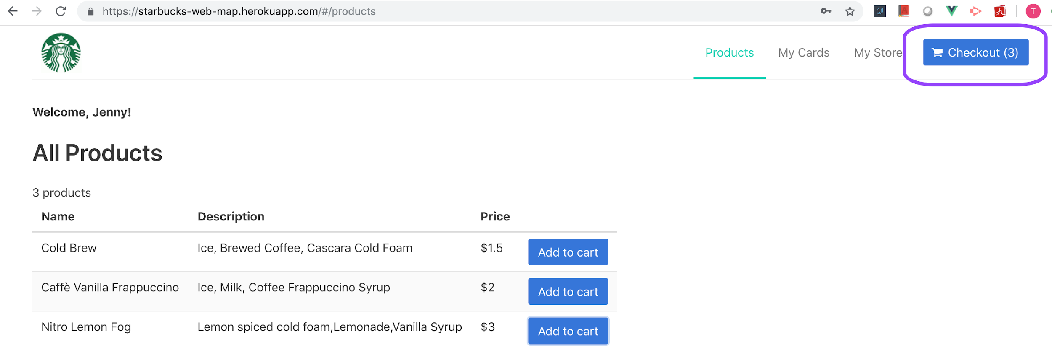
Add to Cart

Slide 22
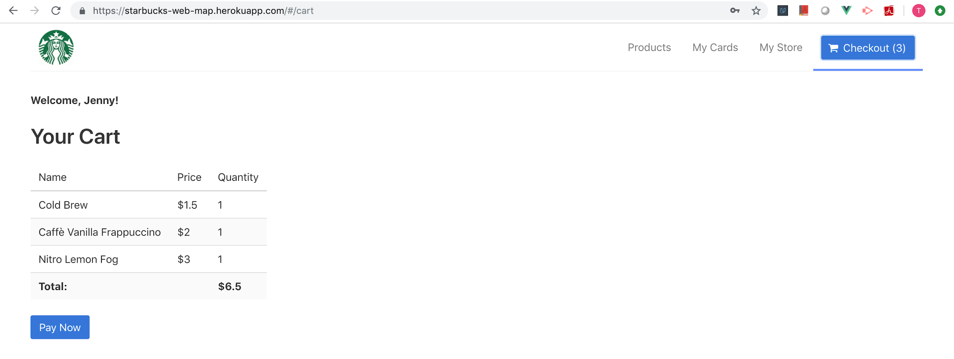
Check Out

Slide 23
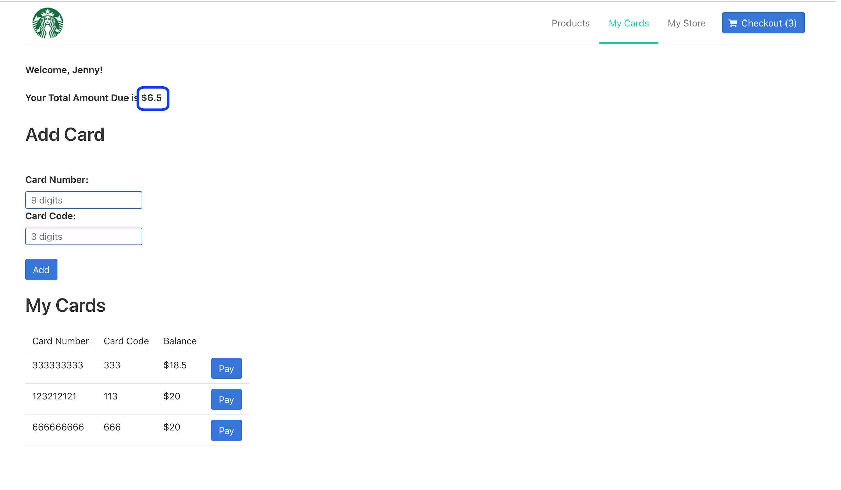

Slide 24
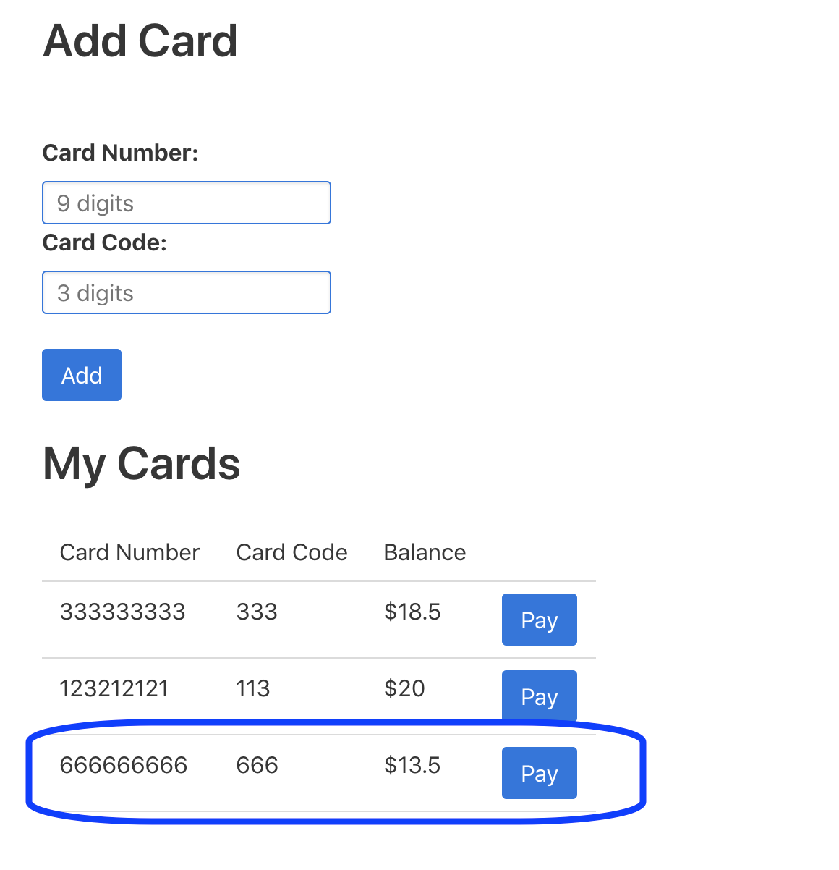
Card Balance

Slide 25
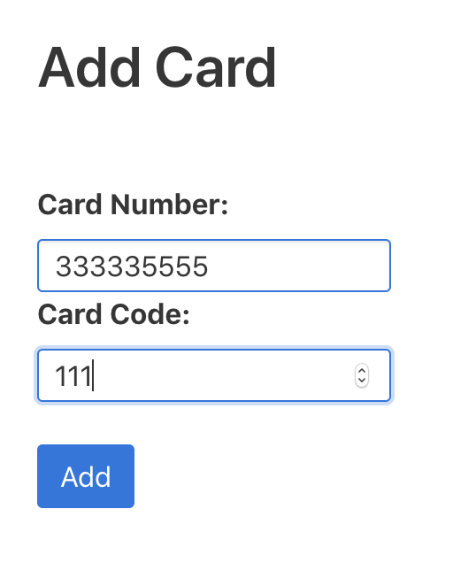
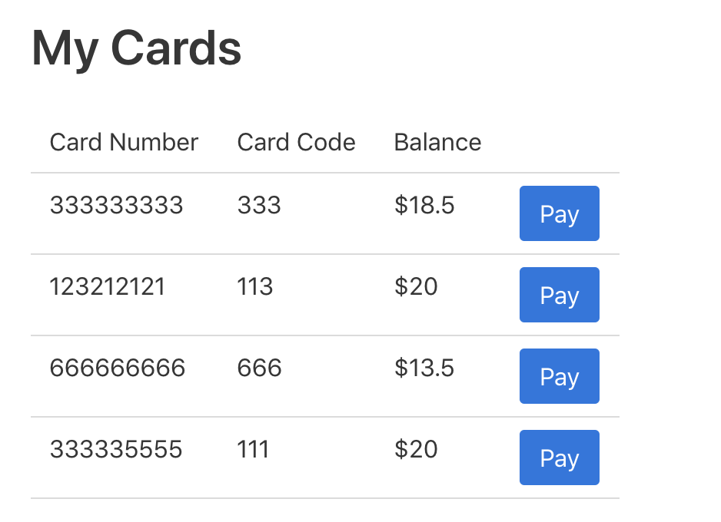
Add Cards

Slide 26
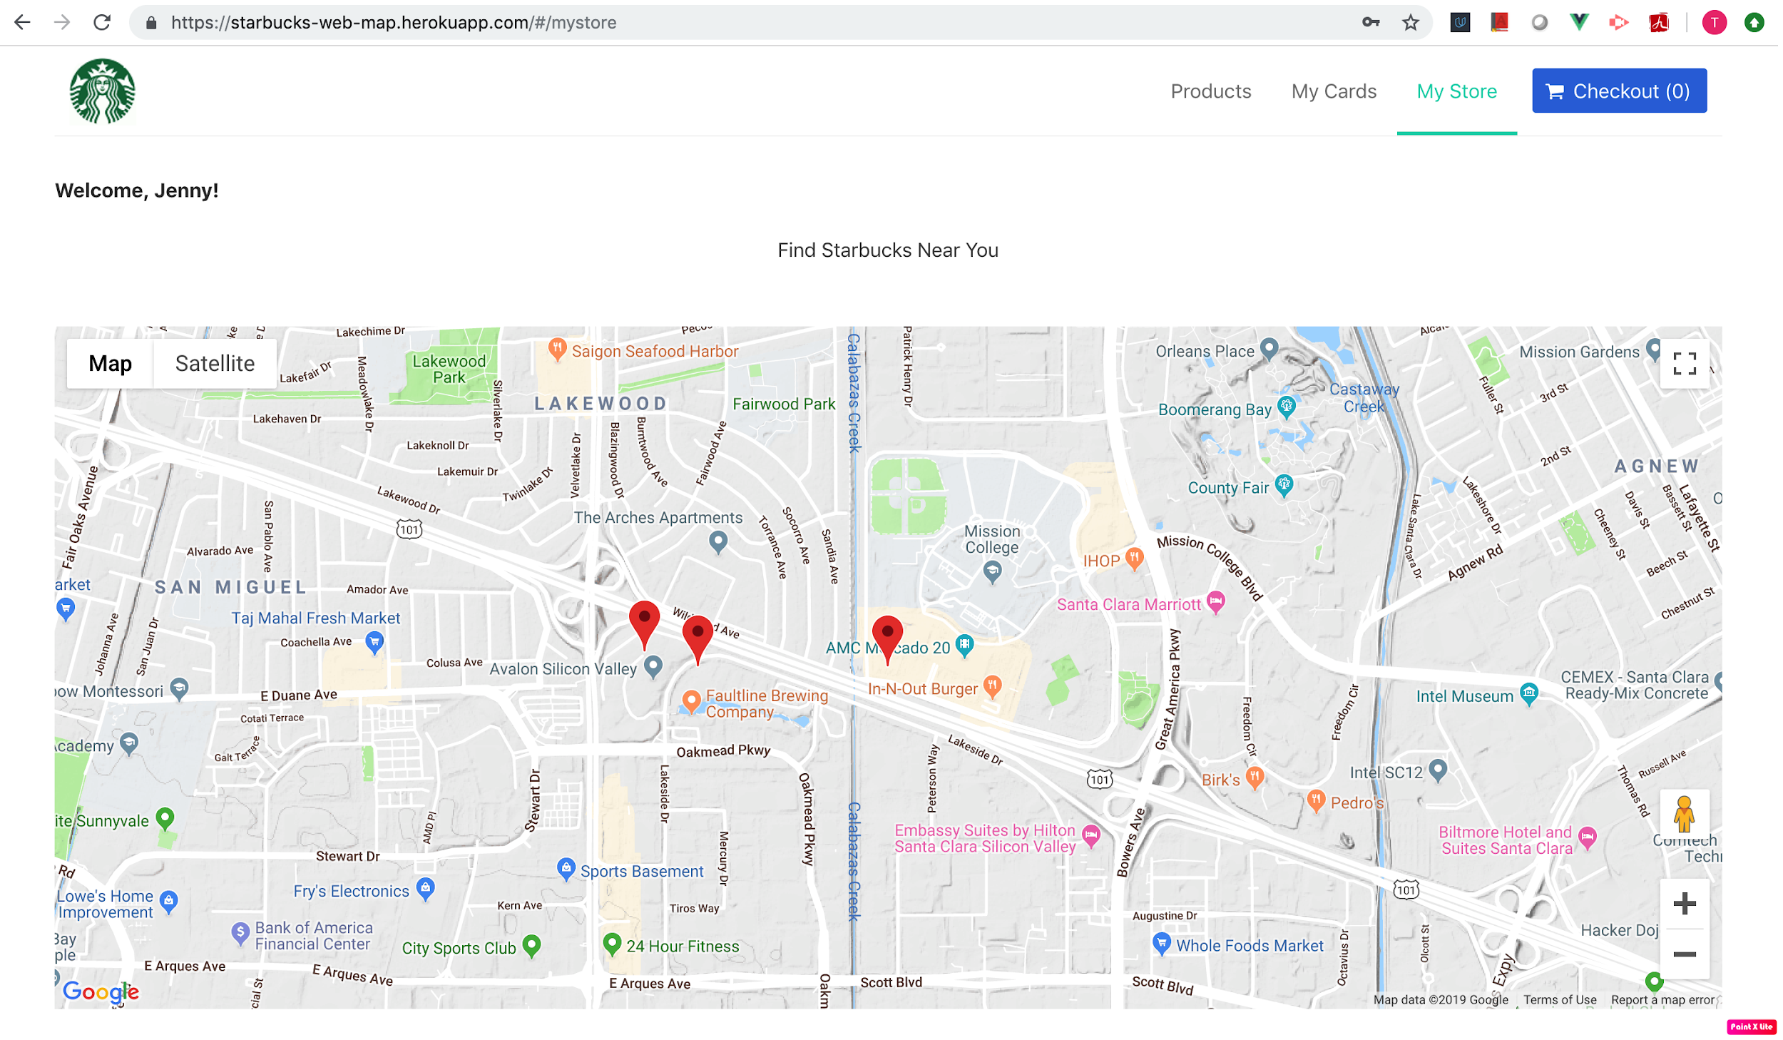
My Store

Slide 27
Thank You!

